Slide 1
BIOLOGY
Class IX

Slide 2
Chapter 2: CELL

Slide 3
What is a Cell?
The cell is the fundamental structural and functional unit of life.
It is the smallest part of the body of an organism which is capable of independent existence and of performing the essential functions of life.
Cells are microscopic hence cannot be seen with the naked eye.
All organisms including ourselves, start life as a single cell called zygote.

Slide 4
Invention of microscope
The first microscope was constructed by Antony Van Leeuwenhoek with a single biconvex lens.
Robert Hooke developed a microscope using two lenses for greater magnification. Which were later known as compound microscopes.

Slide 5
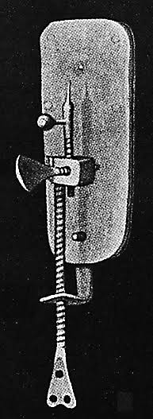
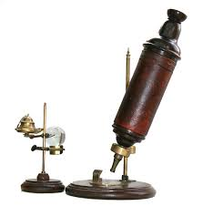
Leeuwenhoek’s microscope
Robert Hooke’s microscope

Slide 6
DISCOVERY OF CELL
Hooke while examining a thin slice of cork under his microscope observed that it was made of tiny box like compartments piled together.
This reminded him of the rooms of a monastery and hence named them cells.
The cells which Hooke saw were all dead cells.

Slide 7
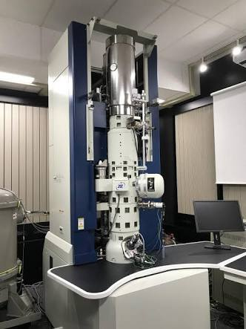
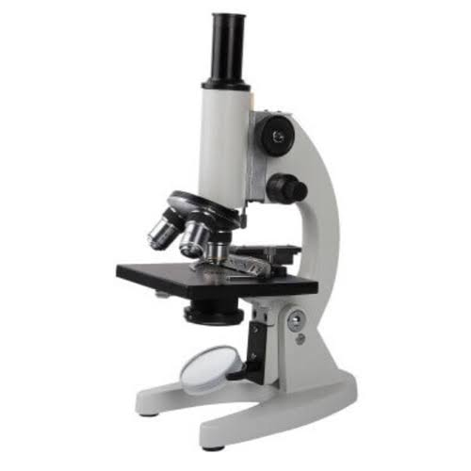
Compound microscope
Electron Microscope

Slide 8
CELL THEORY
It states that :
The cell is the smallest unit of structure of all living things.
The cell is the unit of function of all living things.
All cells arise from pre- existing cells.

Slide 9
Cells: How numerous and how small
Larger the organism, greater the number of cells in its body. For eg. Amoeba is made up of just one cell where as an average sized adult human has 37.2 trillion cells.
Cells are very small and are seen only with a microscope. Smallest cells are the bacteria, largest are the bird’s egg and the longest cells are the nerve cells.

